Slide 1

Music Recognition Tab Presentation
By Conor Murphy

Slide 2
Intro/Description
Application that uses Music Recognition
Returns song title, artist and lesson links
Users who want to learn unknown song on guitar
Lessons from YouTube & UltimateGuitar.com

Slide 3
Research Findings – Audio Content-Base Music Retrieval
Methods of Music Recognition: Audio Identification & Audio Matching
Audio Identification uses Audio Fingerprints
Audio Matching uses Pitch Class Profile

Slide 4
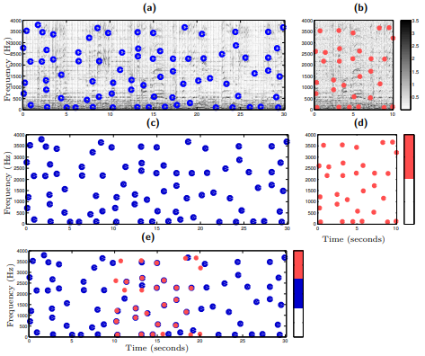
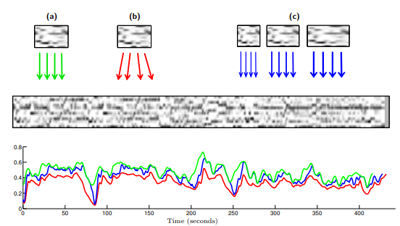
Research Findings – Audio Content-Base Music Retrieval
Audio Identification
Audio Matching

Slide 5
Research Findings – Music Identification & Retrieval Libraries/API
Shazamkit by Apple
Made for mobile apps
Requires Apple Developer Token
ACRCloud
Extremely low database storage
Requires payment after 14 days

Slide 6
Requirements – Similar Application
Shazam – mobile & PC
Advantages: Huge database, quick & accurate, easy-to-use, view history of songs scanned, noise cancelling, identify instrumental songs
Disadvantages: Less known songs can't be identified; mobile apps works in background – use up battery

Slide 7
Requirements – Requirements Modelling
Persona created with survey results
Functional requirements: record sample audio, send to model to identify, return results
Non-functional requirements: microphone permission, simple to use & easy to navigate, quick results, well designed

Slide 8
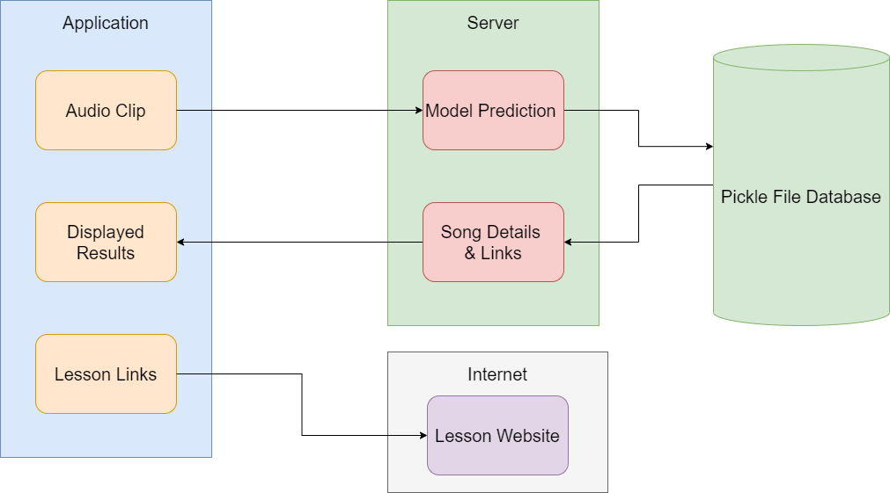
Design – System Architecture

Slide 9
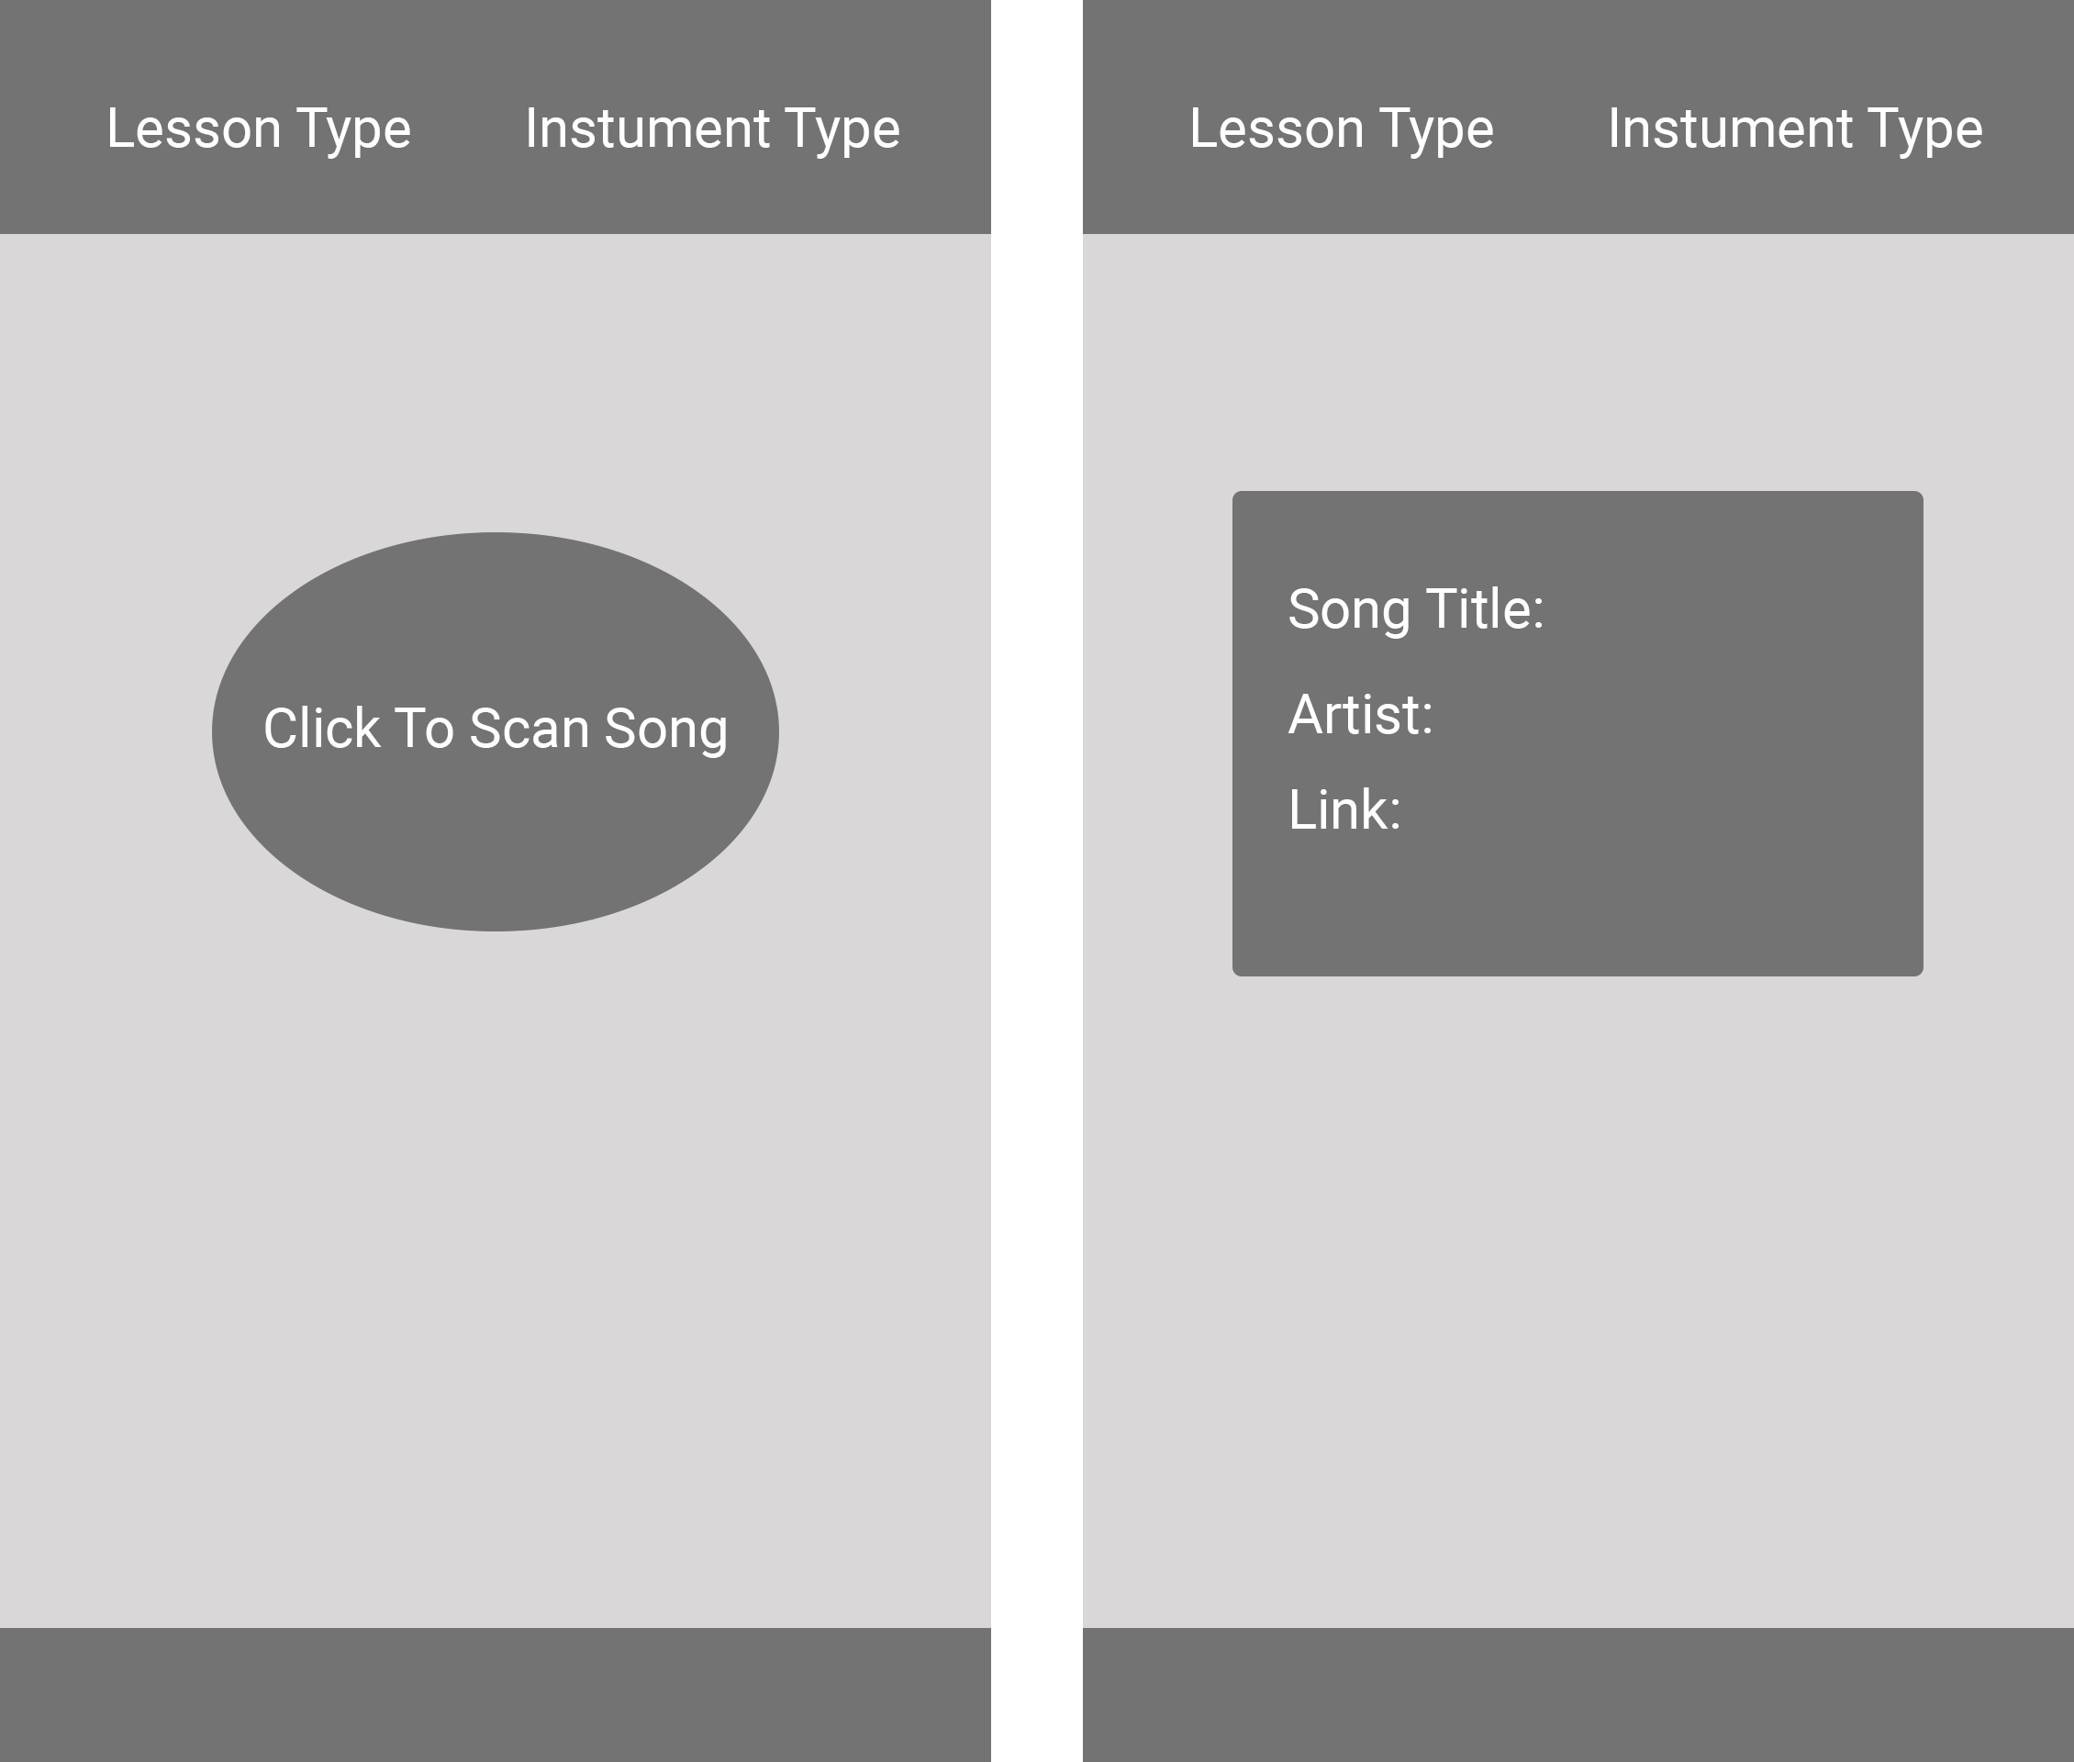
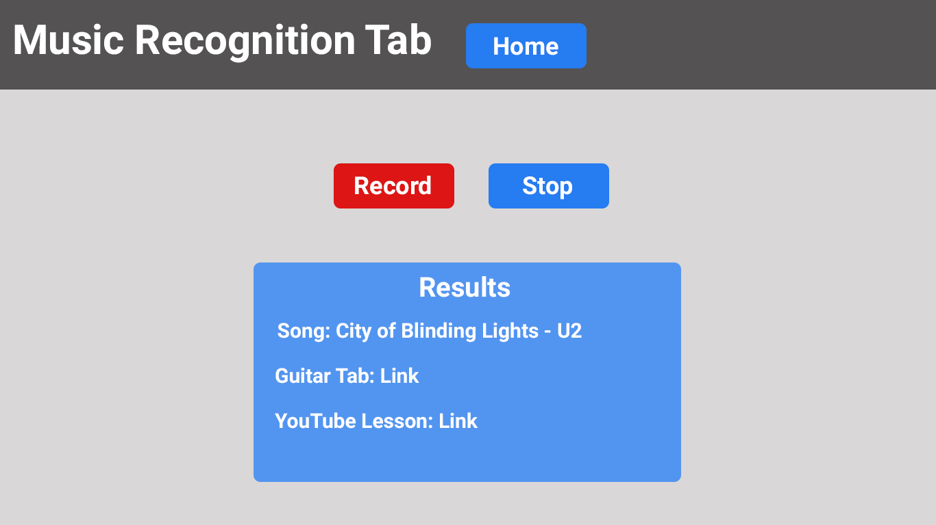
Design – Wireframe & Style Guide

Slide 10
Implementation - Database
Data stored in pickle files
Created in Jupyter Notebook
Testing found only 6 songs can be stored

Slide 11
Implementation - Backend
Backend created with Python
Flask routes use to navigate through the application
Flask route uses render_template
Model in the backend

Slide 12
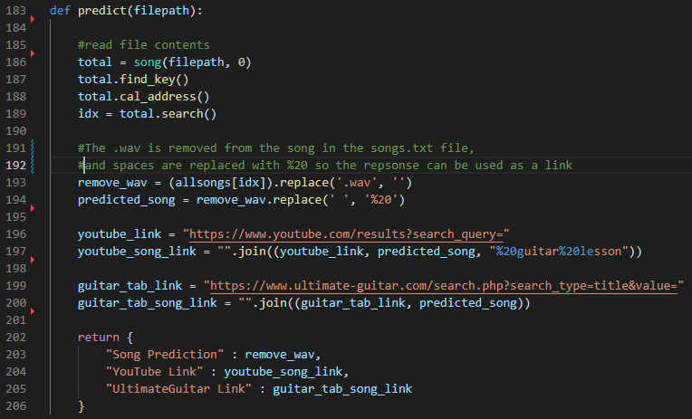
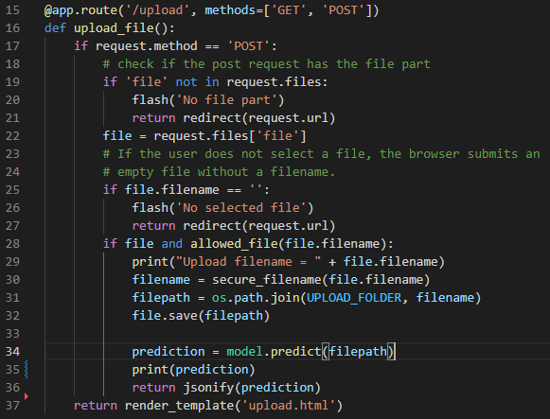
Implementation - Backend

Slide 13
Implementation - Frontend
Frontend uses HTML, CSS & JS
Recorder uses JS
Recorder records for 20 seconds
Audio blob saved in folder
User can playback recording, click link to send to server
JS displays results to user

Slide 14
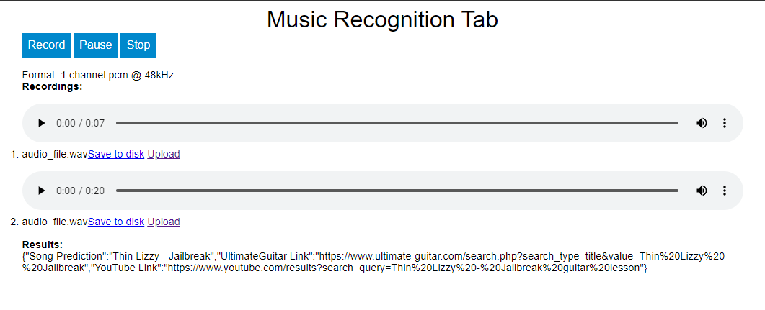
Implementation - Frontend

Slide 15
Testing – Usability
User testing was conducted
Testers rated using the application high
Testers founded application simple to use
Disadvantages was database was small & design simple
Recommended better design & user dashboard

Slide 16
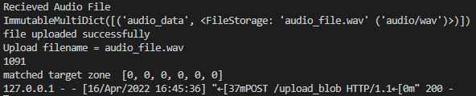
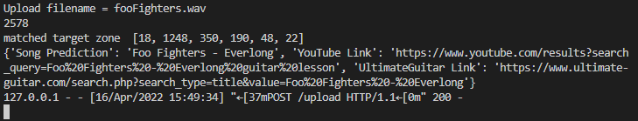
Testing - Algorithm
JavaScript audio file (Top)
Python audio file (Bottom)

Slide 17
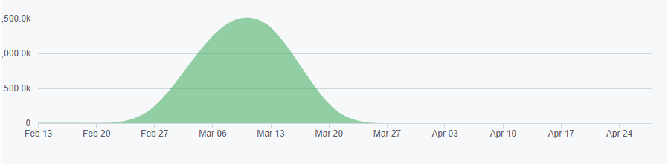
Project Management
Application stored on GitHub
Committed to Repo when work was done on application
Image below displays additions added to Repo

Slide 18
Future Development
Better design – results, links clickable, ect.
Better database
Dashboard for users
Linking to Spotify
Fix bug of audio formatting
Protentional commercial use targeting learning musicians

Slide 19
Appendix - Flask

Slide 20
Research Findings – Flask
Python Web framework
Created by Python team Poco
Uses Werkzeg WSGI Toolkit & Jinja2 Template Engine
Described as microframework

Slide 21
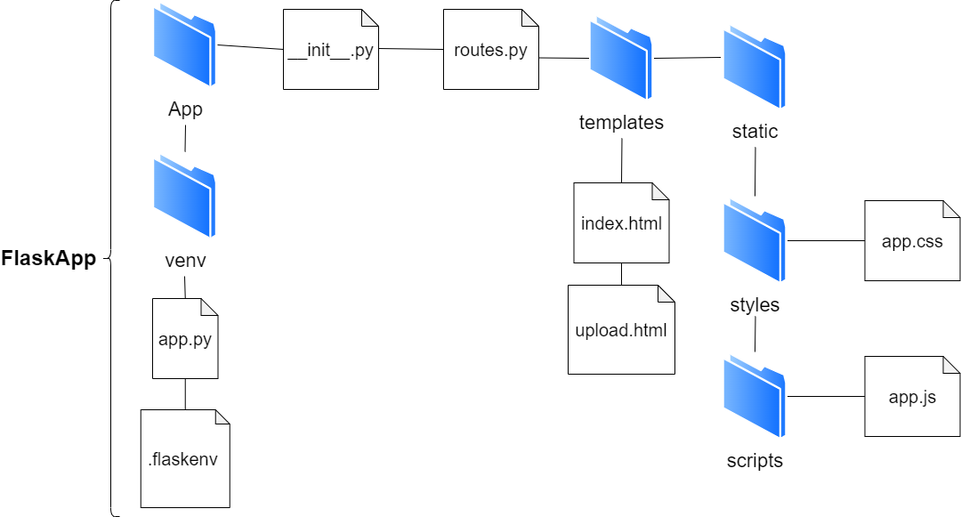
Research Findings – Flask
Flask app folder structure

Slide 22
Links
GitHub - https://github.com/MurpCon28/Music-Recongnition-Tab
Video Demo - https://www.youtube.com/watch?v=zqqtVXgixro

